Slide 1

Brazilian E-commerce Data Analytics
Guided by Partha Chatterjee Sir.
This project dives into analyzing a rich dataset from Olist, one of Brazil's foremost e-commerce platforms, to uncover trends, customer behavior, and business insights within Brazil’s digital marketplace.

Slide 2
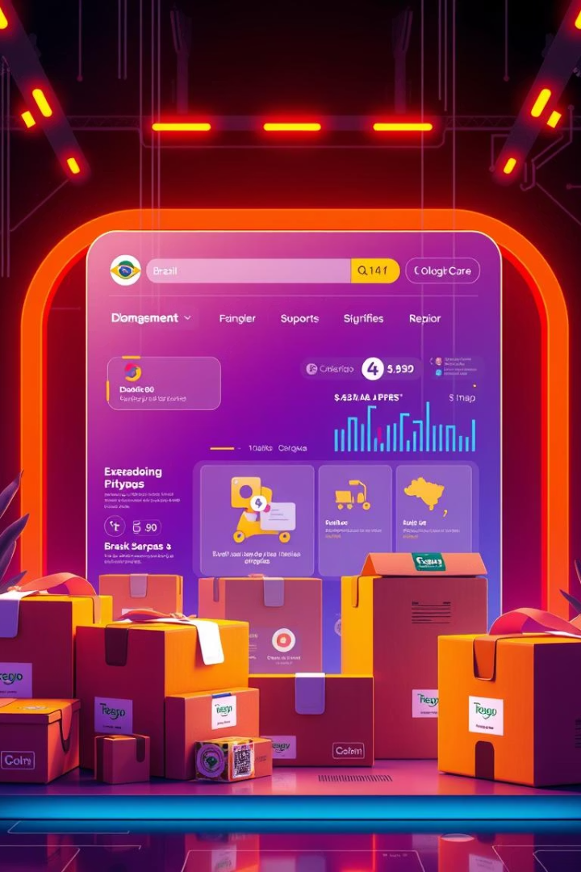
Introduction to the Project
Dataset Overview
The project analyzes Brazil’s largest public e-commerce dataset from Olist, featuring transactional, logistical, and customer review data from 2016 to 2018. This includes orders, payments, products, and geographical details.
Objectives
We focus on trends, seasonality, delivery efficiency, customer satisfaction, payment preferences, and extracting actionable insights to improve business and operational decisions in Brazilian e-commerce.

Slide 3
Dataset Description and Structure
Comprehensive Dataset
Volume and Time Span
The dataset consists of 9 linked CSV files capturing customer, order, product, payment, review, seller, and geolocation information.
Over 100,000 records covering multiple customer journeys and business interactions from 2016 through 2018, enabling rich temporal and behavioral analysis.
Customers: IDs and locations
Orders: timelines and statuses
Payments: method and installments
Reviews: customer feedback and scoring

Slide 4

Tools and Technologies Used
Programming
Python Libraries
Python was the main language, facilitating data manipulation, analysis, and building interactive dashboards.
Pandas for data wrangling
Matplotlib and Seaborn for static plots
Plotly for interactive visualizations
Streamlit for dashboard creation
Development Environment
Exploratory work was conducted in Jupyter Notebook to allow flexible iteration and inline visualization.

Slide 5
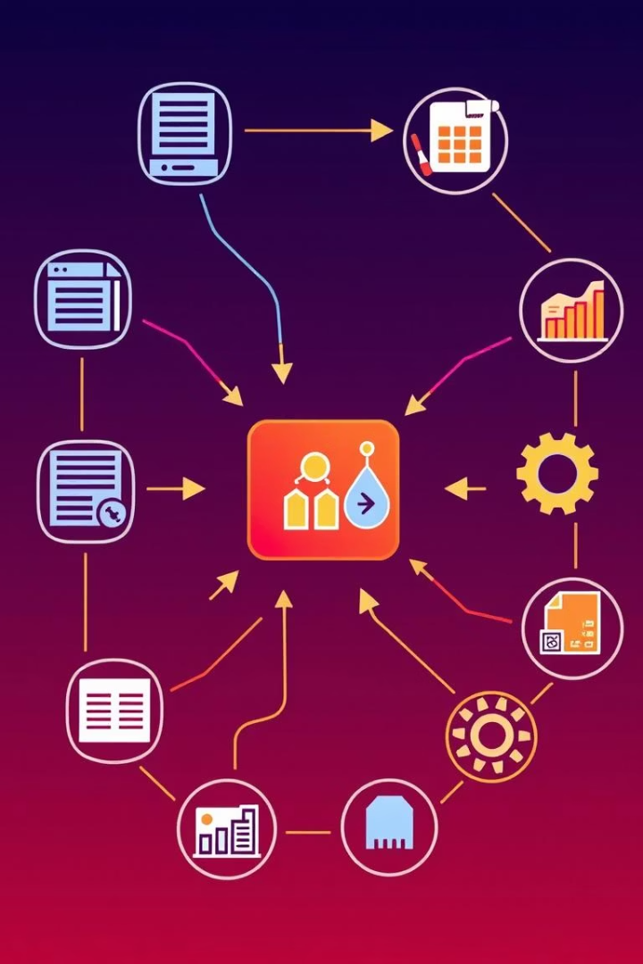




Data Preprocessing Steps
Handling Missing Values
Addressed incomplete fields through removal or imputation to maintain dataset integrity for analysis.
Dataset Merging
Linked multiple tables via order_id, customer_id, and product_id to create a cohesive master dataset.
Duplicates and Anomalies
Removed redundant or inconsistent data entries and corrected errors in product categories and location names.
Date Conversions
Converted date columns to datetime objects enabling time-series analysis and trend identification.

Slide 6
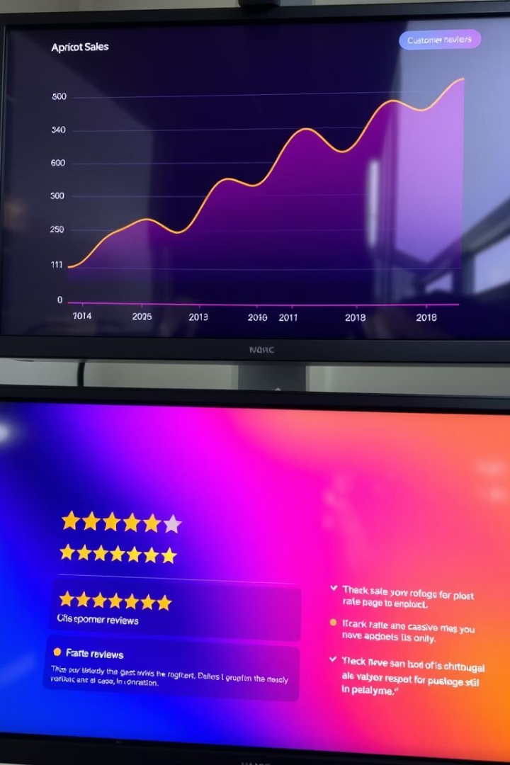




Exploratory Data Analysis (EDA)
Sales Trends
Top Categories
Customer Behavior
Analyzed sales fluctuations over time identifying seasonal patterns and peak shopping periods.
Identified highest selling product categories driving revenue growth in the marketplace.
Explored order frequency, repeat purchases, and preferences through purchasing patterns.
Review Distribution
Examined customer ratings to gauge overall satisfaction and product feedback trends.

Slide 7






Delivery Performance Analysis
Late Deliveries
Calculated percentage of orders delivered past estimated dates to identify bottlenecks.
Average Delivery Time
Measured actual delivery times compared to estimated windows, revealing delays.
Regional Patterns
Analyzed delivery times by region, highlighting geographic disparities and logistics challenges.

Slide 8

Payment Method Analysis
Payment Type
Usage Percentage
Credit Card
65%
Boleto
25%
Voucher
10%
Credit cards dominate the payment landscape, followed by boleto slips commonly used in Brazil. Installment purchasing is prevalent, reflecting local consumer preferences. Revenue breakdown shows strong reliance on credit transactions for high-value sales.

Slide 9

Key Business Insights
Top Categories
Regional Sales
Customer Satisfaction
Electronics and home appliances lead sales, showing sustained consumer demand.
São Paulo and Rio de Janeiro stand out as highest sales states, driven by population and infrastructure.
Positive review patterns correlate with faster delivery and better product quality, crucial for retention.

Slide 10

Future Directions and Opportunities
Recommendation System
Implement collaborative and content-based filtering to personalize shopping experiences using purchase and review data.
Machine Learning for Satisfaction Prediction
Build models to forecast customer satisfaction levels leveraging delivery, payment, and product features.
Real-Time Dashboard Integration
Develop interactive Power BI dashboards for live monitoring of key metrics, aiding timely decision-making for stakeholders.

